Slide 1

CSCI/ARTI 8950 Machine Learning
Lecture Notes 9: Multiclass Classification
Khaled Rasheed
Professor
School of Computing
Member
Institute for Artificial Intelligence
University of Georgia
Credit: some examples & figures by Marine Carpuat, Tom Mitchell and Hal Daumé III

Slide 2
Topics
Using standard binary classifiers to solve
other problems
Weighted classification
Multiclass classification
Algorithms & guarantees on error rate
Fundamental ML concept: reduction

Slide 3
Imbalanced data distributions
Sometimes training examples are drawn
from an imbalanced distribution
This results in an imbalanced training set
“needle in a haystack” problems
E.g., find fraudulent transactions in credit card histories
The class of interest is the minority class (usually the positive class)
Why is this a big problem for the ML algorithms we know?

Slide 4
Recall: Machine Learning as Function Approximation
Problem setting
Set of possible instances 𝑋
Unknown target function 𝑓: 𝑋 → 𝑌
Set of function hypotheses 𝐻 = ℎ
ℎ: 𝑋 → 𝑌}
Input
Training examples { 𝑥 ¹ , 𝑦 ¹
target function 𝑓
, … 𝑥 ^{𝑁} , 𝑦 ^{𝑁}
} of unknown
Output
Hypothesis ℎ ∈ 𝐻 that best approximates target function 𝑓

Slide 5
Recall: Expected loss
𝑓 should make good predictions
as measured by loss 𝑙
on future examples that are also drawn from 𝐷
Formally
𝜀 , the expected loss of 𝑓 over 𝐷 with respect to 𝑙 should be small
^{𝜀 ≜ 𝔼} 𝑥,𝑦 ~𝐷
𝑙(𝑦, 𝑓(𝑥)) =

Slide 6
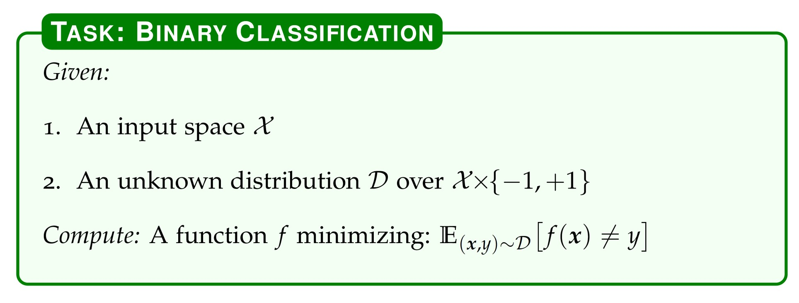

Slide 7
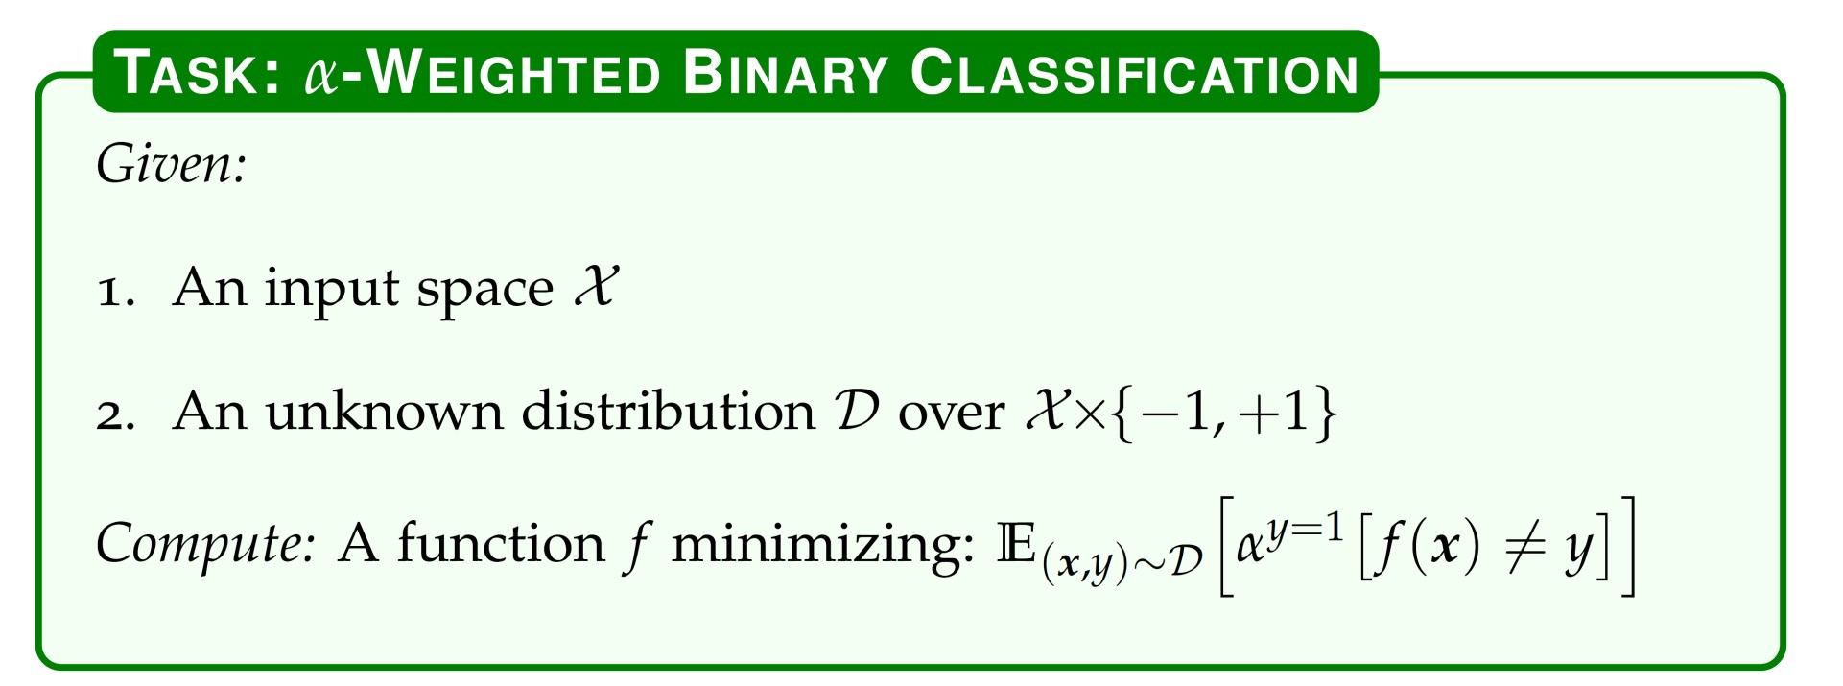
α > 1 for y = +1
1 for y = -1
Given a good algorithm for solving the binary classification problem, how can we solve the α-weighted binary classification problem?

Slide 8
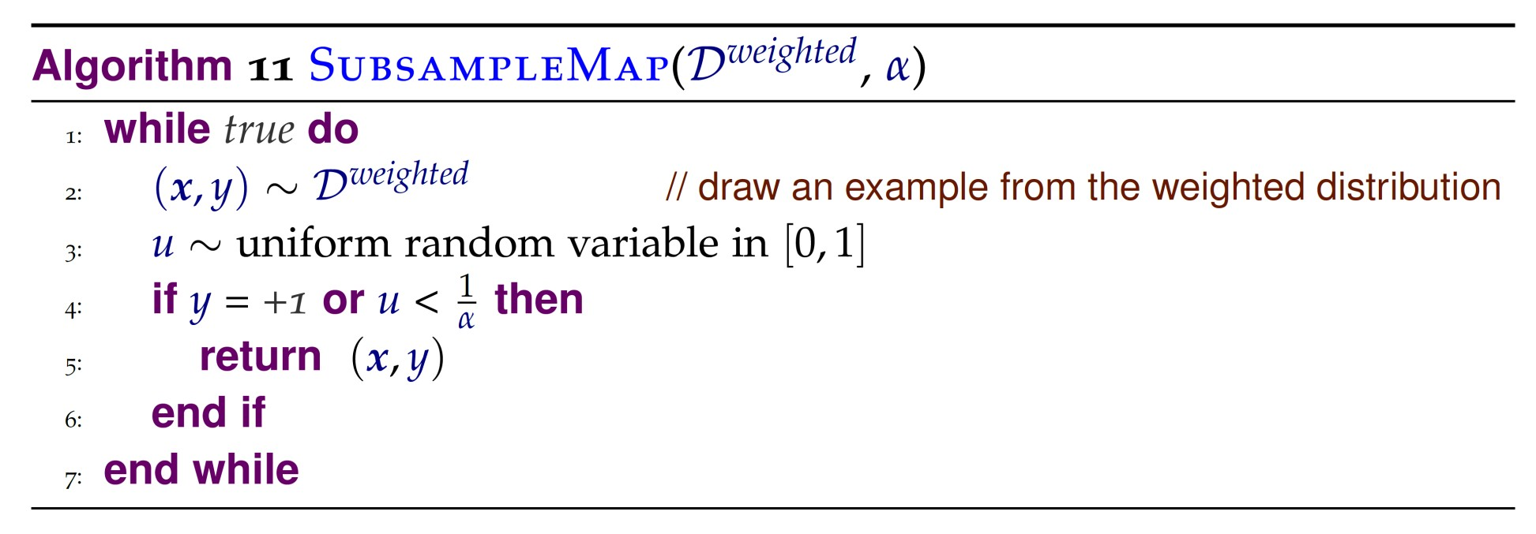
Solution: Train a binary classifier on an induced distribution

Slide 9
Subsampling optimality
Theorem: If the binary classifier achieves a binary error rate of ε, then the error rate of the α-weighted classifier is α ε
(see CIML 6.1 for proof)

Slide 10
Strategies for inducing a new binary distribution
Undersample the negative class
Oversample the positive class

Slide 11
Strategies for inducing a new binary distribution
Undersample the negative class
More computationally efficient
Oversample the positive class
Base binary classifier might do better with more training examples
Efficient implementations incorporate weight in algorithm, instead of explicitly duplicating data!

Slide 12
Reductions
Idea is to re-use simple and efficient algorithms for binary classification to perform more complex tasks
Works great in practice:
– E.g., Vowpal Wabbit

Slide 13
Learning with Imbalanced Data is an Example of Reduction
Subsampling Optimality Theorem:
If the binary classifier achieves a binary error rate of ε, then
the error rate of the α-weighted classifier is α ε

Slide 14
Multiclass classification
Real world problems often have multiple classes (text, speech, image, biological sequences…)
How can we perform multiclass classification?
Straightforward with decision trees or KNN
Can we use the perceptron algorithm?

Slide 15
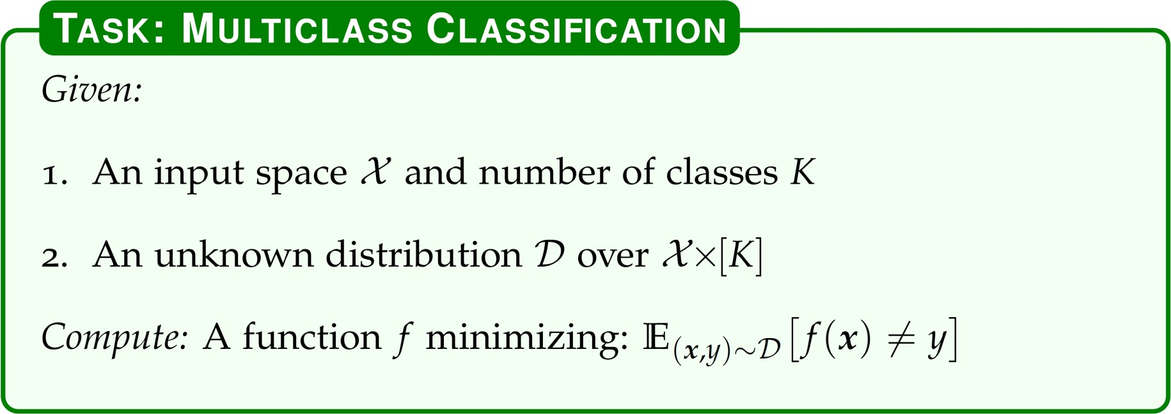
Today: Reductions for Multiclass Classification

Slide 16
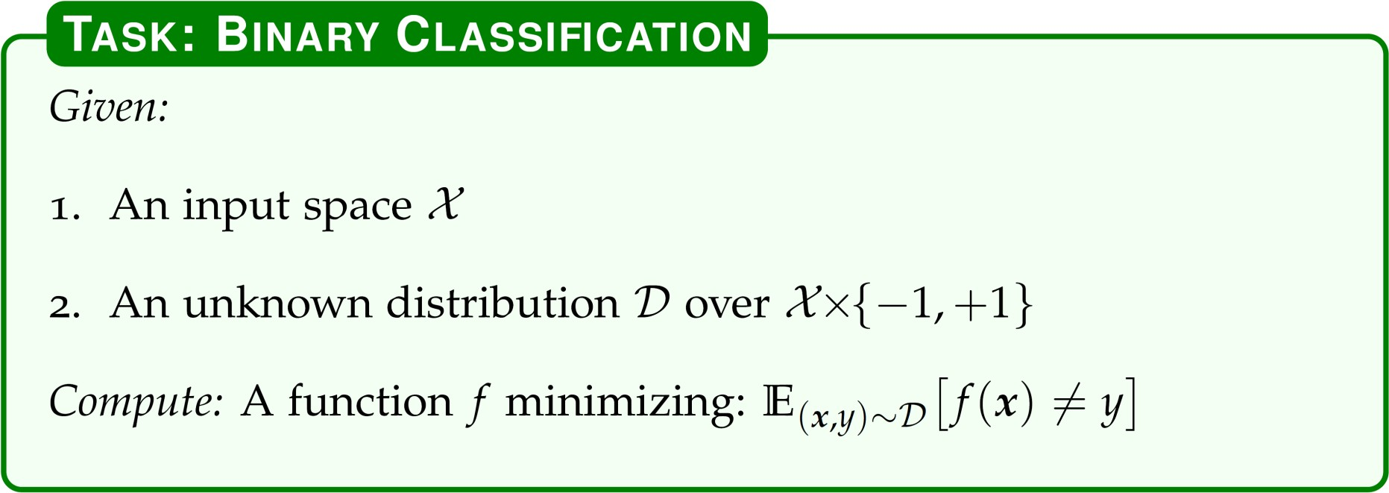

Slide 17
How many classes can we handle in practice?
In most tasks, number of classes K < 100
For much larger K
we need to frame the problem differently
e.g, machine translation or automatic speech recognition
If K > 10, Hierarchical (tree) classification may be necessary

Slide 18
Reduction 1: OVA
“One versus all” (aka “one versus rest”)
Train K-many binary classifiers
classifier k predicts whether an example belong to class k or not
At test time,
If only one classifier predicts positive, predict that class
Break ties randomly

Slide 19
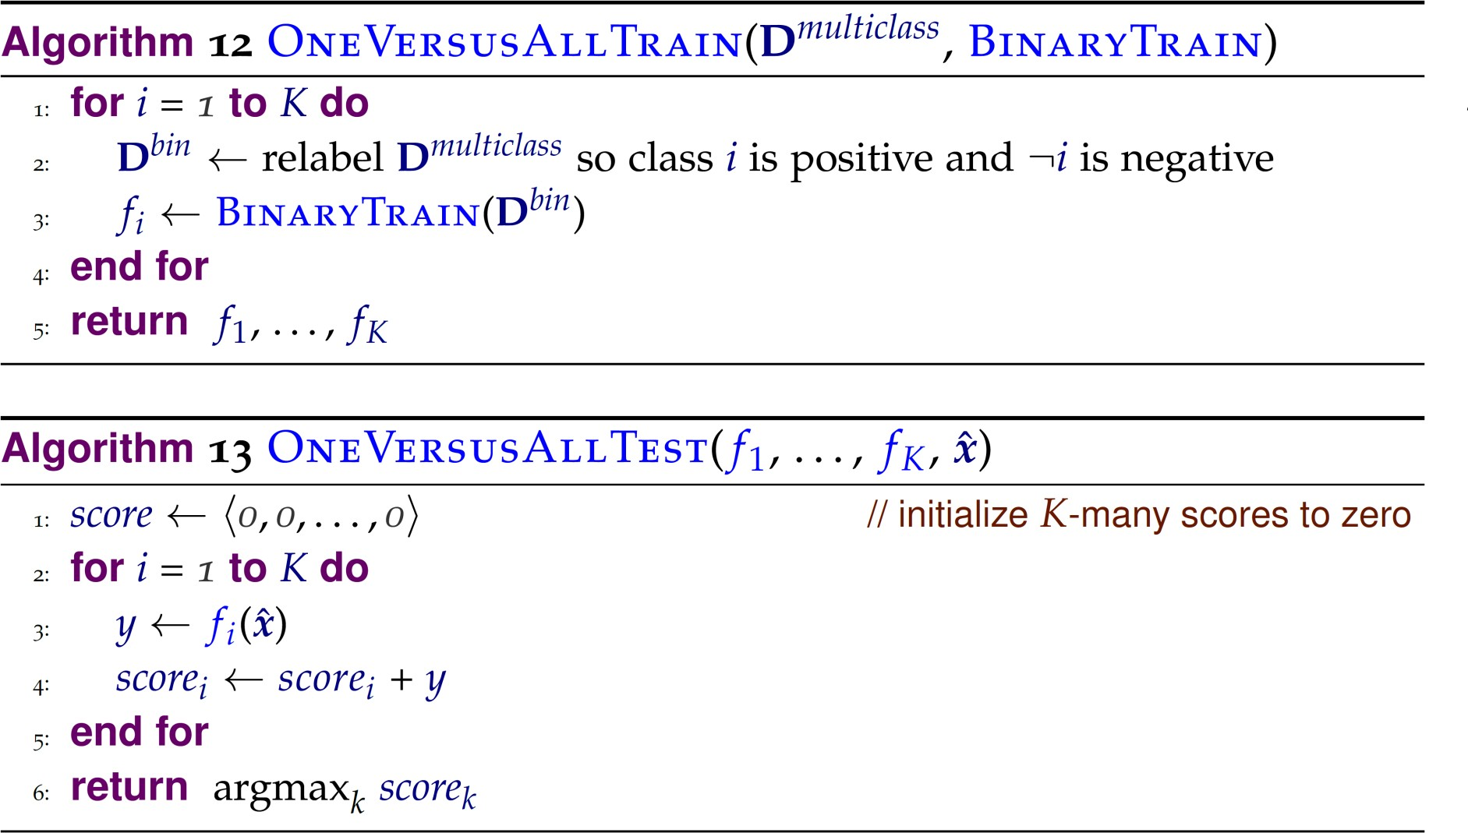

Slide 20
Time complexity
Suppose you have N training examples, in K classes. How long does it take to train an OVA classifier
if the base binary classifier takes O(N) time to learn?
if the base binary classifier takes O(N^2) time to learn?

Slide 21
Error bound
Theorem: Suppose that the average error of the K binary classifiers is ε, then the error rate of the OVA multiclass classifier is at most (K-1) ε
To prove this: how do different errors affect the maximum ratio of the probability of a multiclass error to the number of binary errors (“efficiency”)?

Slide 22
Error bound proof
If we have a false negative on one of the binary classifiers (assuming all other classifiers correctly output negative)
What is the probability that we will make an incorrect multiclass prediction?
(K – 1) / K
Efficiency: ( K – 1) / K / 1 = (K – 1 ) / K

Slide 23
Error bound proof
If we have p false positives with the binary classifiers
What is the probability that we will make an incorrect multiclass prediction?
If there is also a false negative: 1
Efficiency =1 / ( p + 1 )
If there is no false negative: p / ( p + 1)
Efficiency = p / (p + 1) / p = 1 / ( p + 1)

Slide 24
Error bound proof
What is the worst case scenario?
False negative case: efficiency is (K-1)/K
Larger than false positive efficiencies
There are K-many opportunities to get false negative, overall error bound is (K-1) ε

Slide 25
Reduction 2: AVA
All versus all (aka all pairs)
How many binary classifiers does this require?

Slide 26
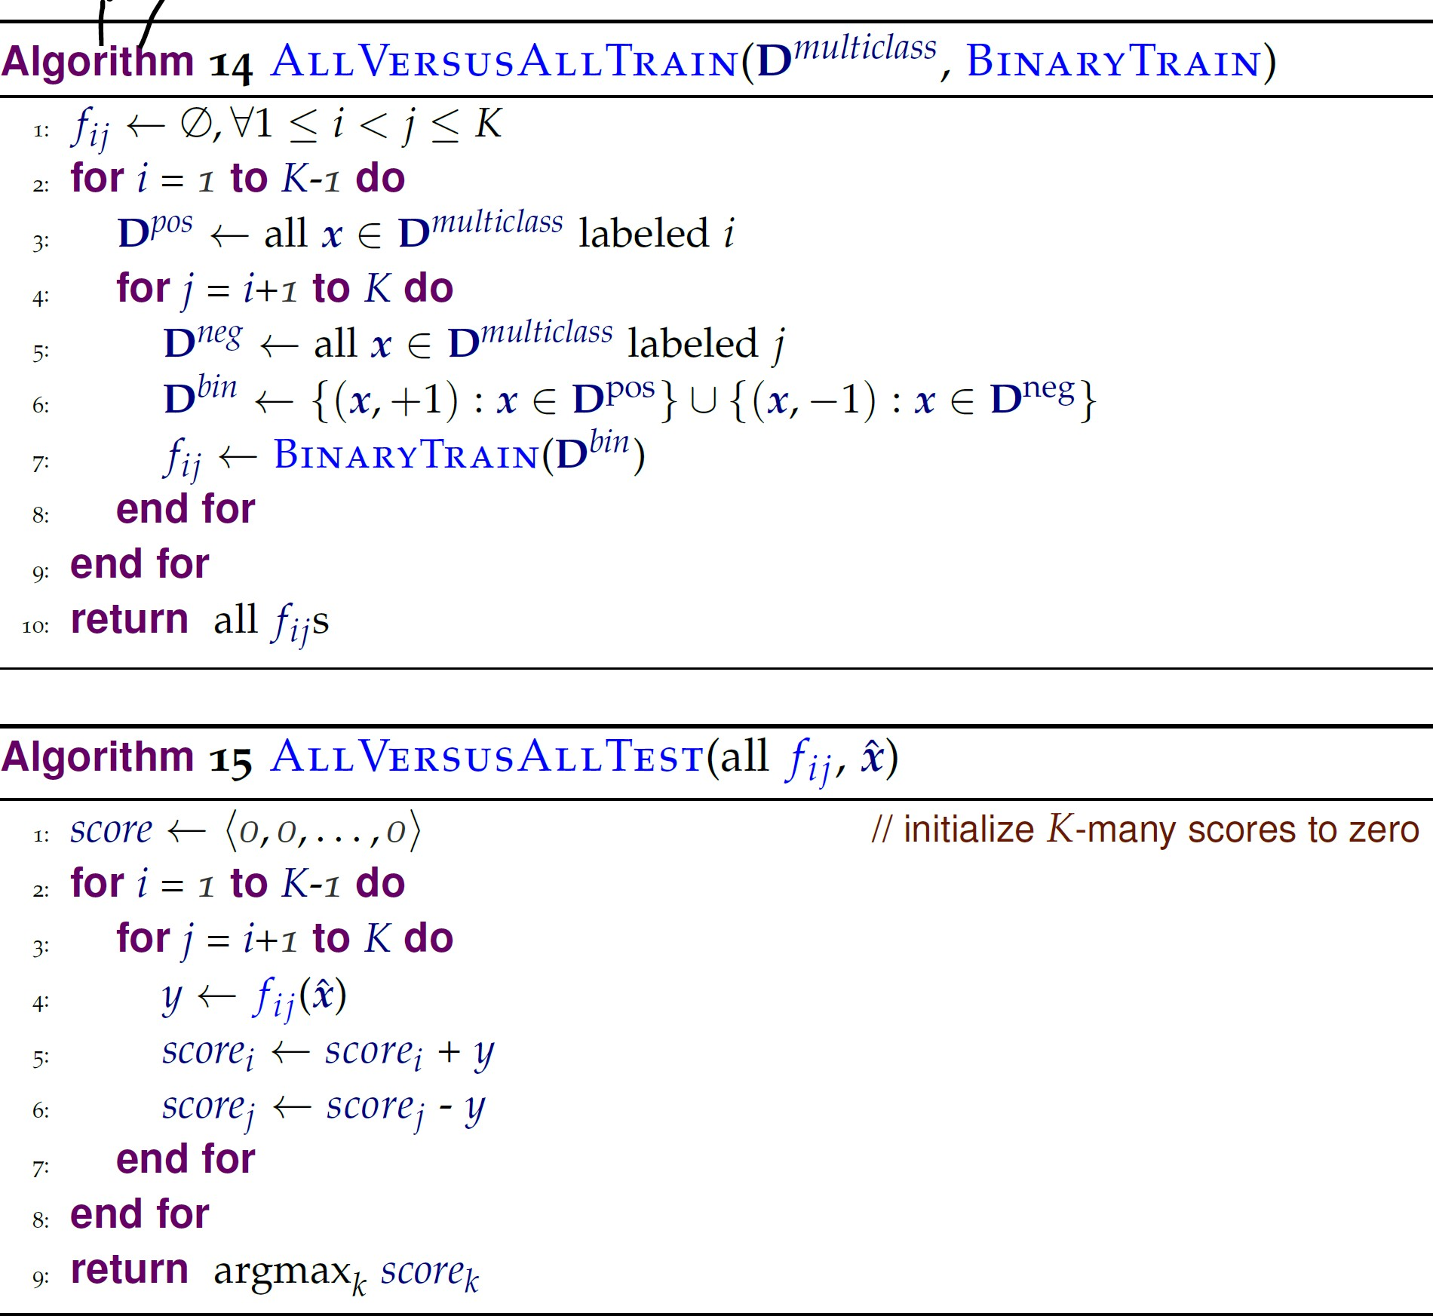

Slide 27
Time complexity
Suppose you have N training examples, in K classes. How long does it take to train an AVA classifier
if the base binary classifier takes O(N) time to learn?
if the base binary classifier takes O(N^2) time to learn?

Slide 28
Error bound
Theorem: Suppose that the average error of the K binary classifiers is ε, then the error rate of the AVA multiclass classifier is at most 2(K-1) ε
Question: Does this mean that AVA is always worse than OVA?

Slide 29
Extensions
Divide and conquer (Hierarchical classification)
Organize classes into binary tree structures
Problem: errors will cascade
Use confidence to weigh predictions of binary classifiers
Instead of using majority vote

Slide 30
Ranking
Canonical example: web search
Given all the documents on the web
For a user query, retrieve relevant documents, ranked from most relevant to least relevant

Slide 31
How can we reduce ranking to binary classification?

Slide 32
Preference function
Given a query q and documents di and dj, the preference function outputs whether
di should be preferred to dj
Or dj should be preferred to di
That’s a binary classification problem!

Slide 33
Specifiying the reduction from ranking to binary classification
How to train classifier that predicts preferences?
How to turn the predicted preferences into a ranking?

Slide 34
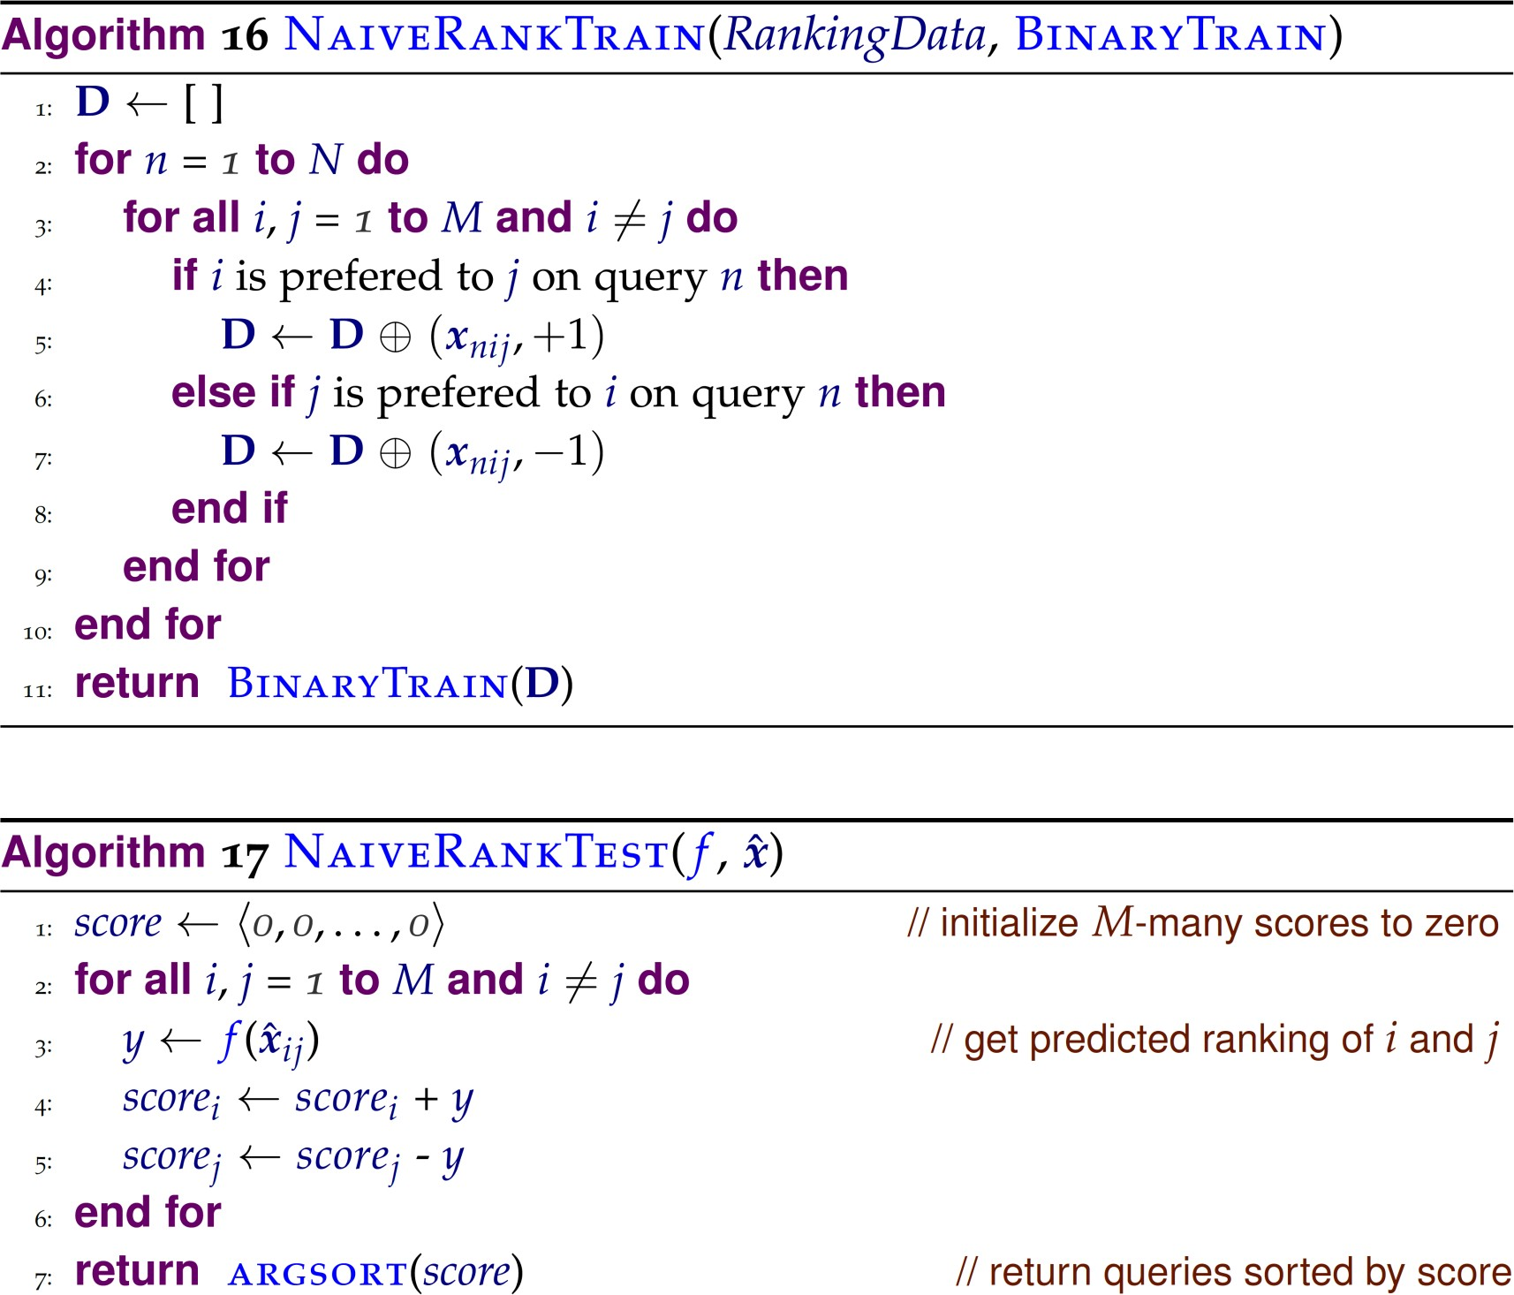
Features associated with comparing document i and document j for query n

Slide 35
Naïve approach
Works well for bipartite problems
“is this document relevant or not?”
Not ideal for full ranking problems, because
Binary preference problems are not all equally important
Separates preference function and sorting

Slide 36
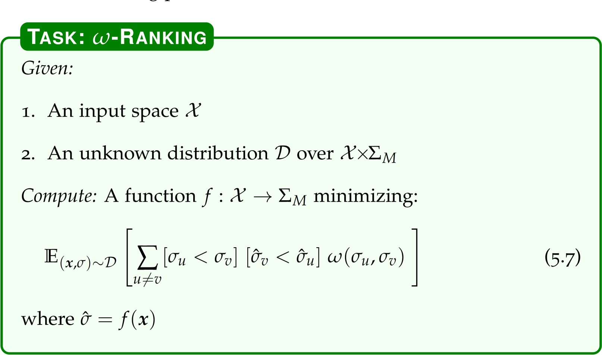
Improving on naïve approach

Slide 37

Example of cost functions

Slide 38
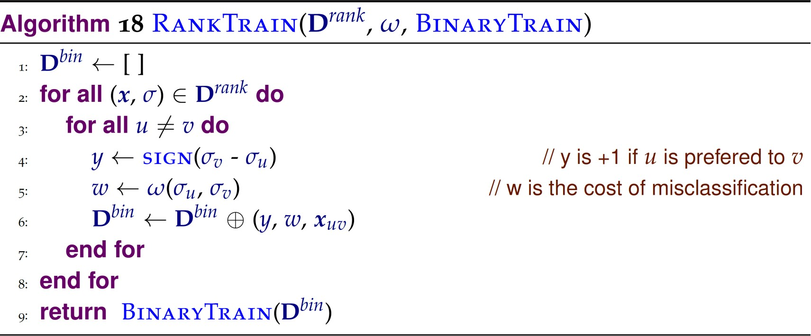
Resulting Ranking Algorithms

Slide 39
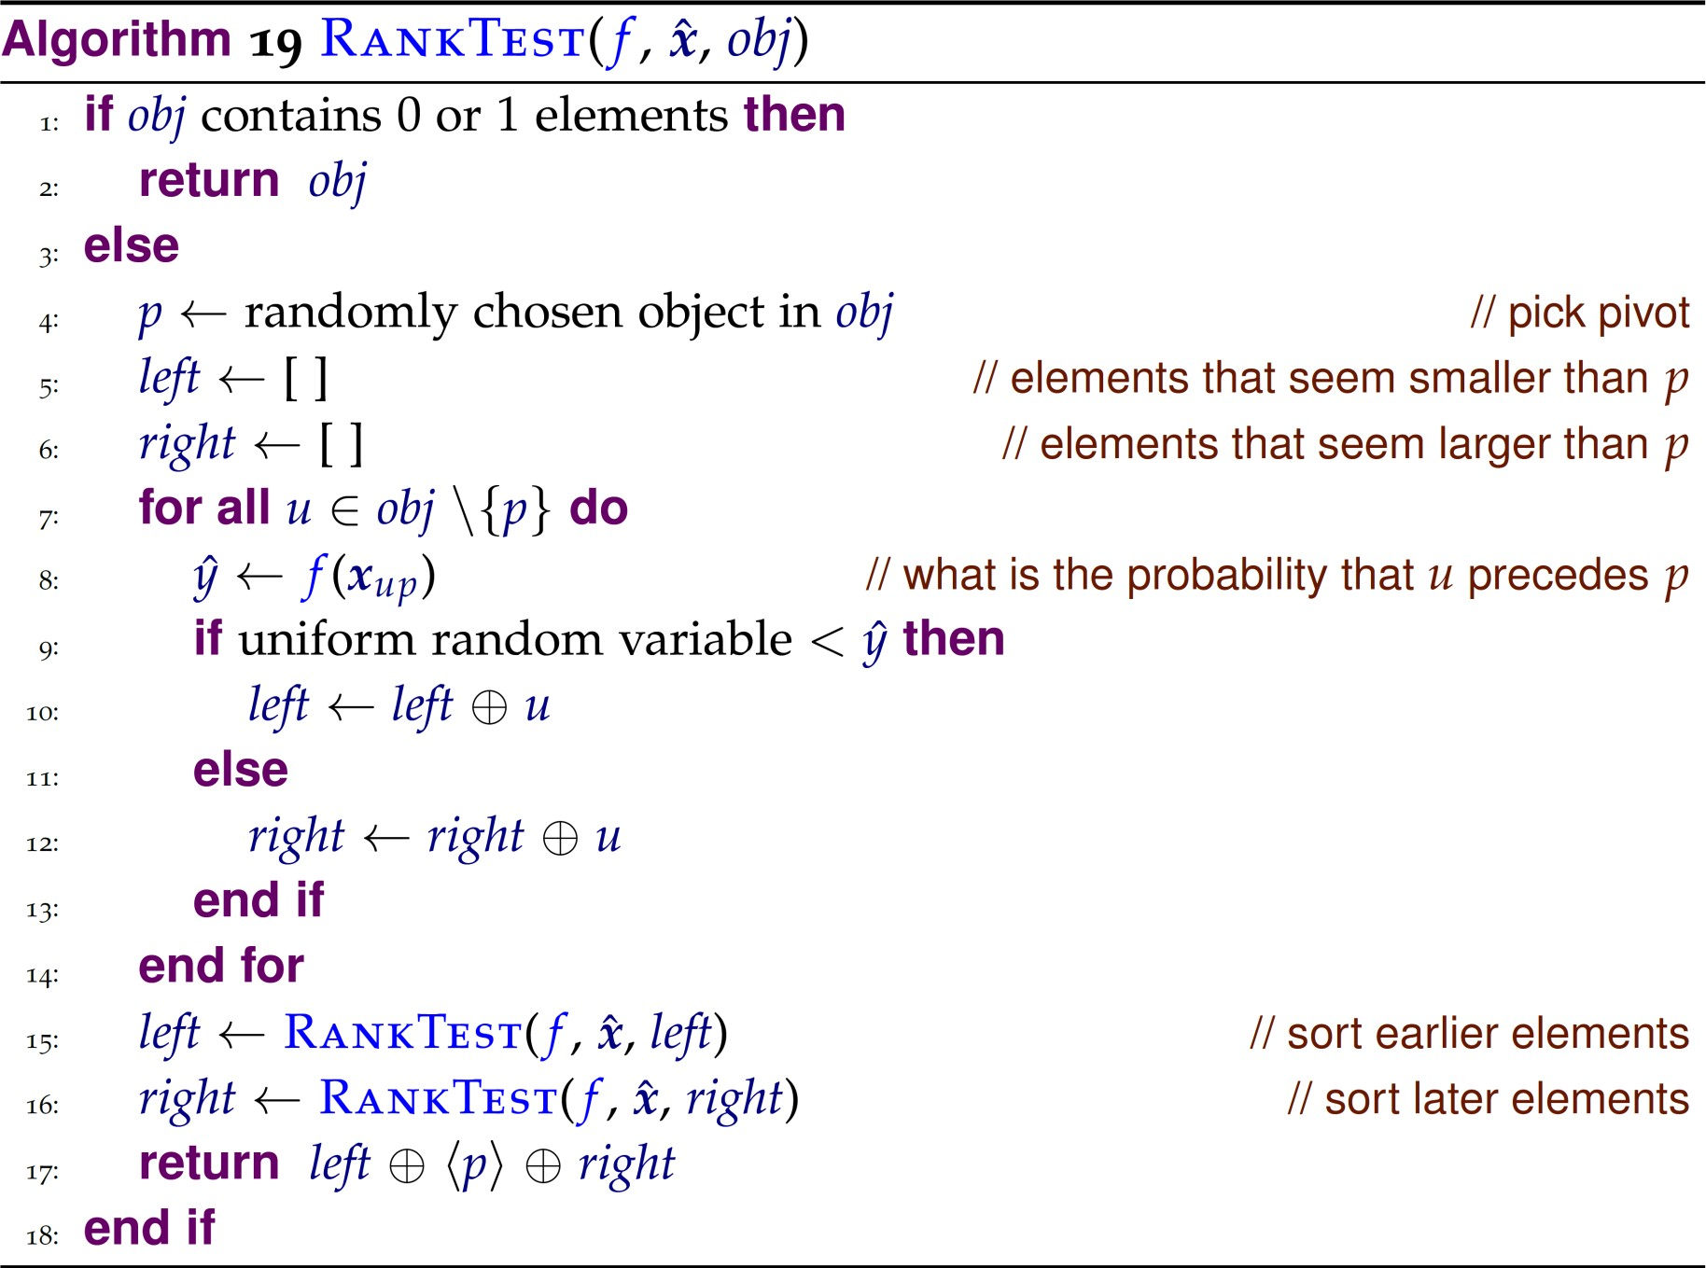

Slide 40
RankTest
A probabilistic version of the quicksort algorithm
Only O(Mlog2M) calls to f in expectation
Better error bound than naïve algorithm
(see CIML for theorem)

Slide 41
What you should know
What are reductions and why they are useful
Understand, analyze error bounds of algorithms for
Weighted binary classification
Multiclass classification (OVA, AVA)
Understand algorithms for
𝜔 −ranking

